Slide 1
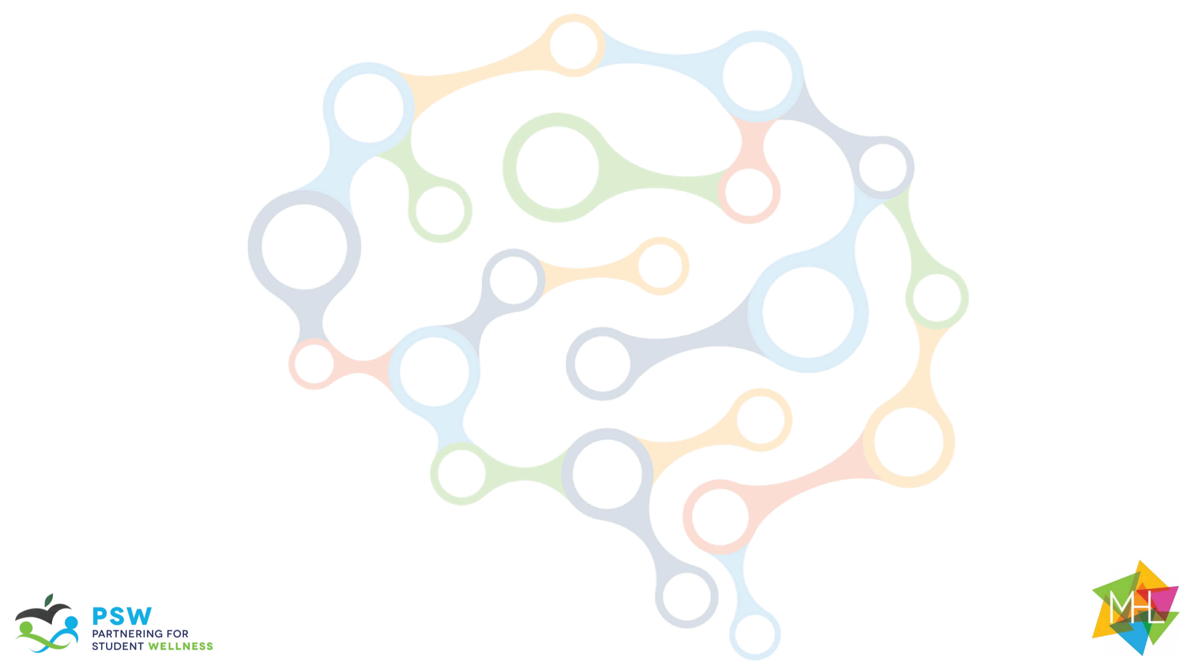
The Guide
Understanding Mental Health
and Mental Illness

Slide 2
Table of Contents
Topic A: What is mental health?
Topic B: How is the brain involved in mental health?
Topic C: What is stigma?
Topic D: How can a person find support?
Topic E: How can positive mental health be maintained?

Slide 3

Acknowledgements
Research reported in this work was funded through a Patient-Centered Outcomes Research Institute (PCORI) Project Program Award (IHS-2018C1-10928). The views in this work are solely the responsibility of the authors and do not necessarily represent the views of the Patient-Centered Outcomes Research Institute (PCORI), its Board of Governors, or Methodology Committee.

Slide 4
Acknowledgements: The Guide Citations
McLuckie, A., Kutcher, S., Wei, Y (Co-PI)., & Weaver, C. (2014). Sustained improvements in students’ mental health literacy with use of a mental health curriculum in Canadian schools. BMC Psychiatry, 14(1), 379. doi: 10.1186/s12888-014-0379-4 (The Guide)
Milin, R., Kutcher, S., Lewis, S., Walker, S., Wei, Y (Contributor)., Ferrill, N., & Armstrong, M. (2016). Impact of a mental health curriculum on knowledge and stigma among high school students: a randomized controlled trial. Journal of American Academy of Child and Adolescent Psychiatry, 55(5), 383-391.e1. doi: 10.1016/j.jaac.2016.02.018 (The Guide 2016 RCT)

Slide 5
Slide Notes
Each slide deck follows the same format. Once you are comfortable with the layout and process for Topic A, the rest should be very easy to follow.
Each slide includes presenter notes that include the following elements, as applicable:
  Say – a brief script you can follow or adapt to fit your style and classroom needs
  Ask – question(s) to initiate conversation and engagement with students
  Do – an action you can initiate (e.g., “call on a few students to respond.”)
Some slides offer options in the notes section for how you might facilitate each activity. Educators should be able to quickly review the slide deck and accompanying notes before implementing in the classroom.

Slide 6
Outline for Topic E
Topic E: How can positive mental health be maintained?
Background Information for Facilitators | Topic E Knowledge for Facilitators
Introduction: | Core topics include: Learn about stress, helpful stress reduction techniques, and how to apply stress reduction techniques to enhance mental and physical health
Review: | Rules and Incentive System (if available)
Topic Activities: | Activity 1 : Create Your Happy Place Activity 2 : Guided Relaxation Breathing Activity 3: Box Breathing Activity 4: Progressive Muscle Relaxation Activity 5: Strategies for Maintaining Positive Mental Health
Optional Activities: | N/A
Conceptual Understanding: | Real Life Example

Slide 7
Session Goals, Materials and Preparation Needed
SESSION GOALS
Learn about what the stress response is and how to use it to help develop resilience
Learn when to apply stress reduction techniques and what kinds of stress reduction techniques can be helpful
Learn and apply activities designed to enhance both mental and physical health
Materials
Power Point: Topic E
For Activity 1: Paper, pencils, crayons, poster board, magazines, scissors, glue, tape
Student and Teacher Handouts: None
Preparation
Review “Background for Facilitators” in this slide deck, particularly the final page
Prep Conceptual understanding activity in advance. What “project” do you want students to do?
Prep videos: Guided Relaxed Breathing and Box Breathing
Print Student Certificates (last slide)

Slide 8
Background Knowledge
Positive mental health is about having healthy coping strategies to deal with the stresses of life. Although previously stated, it is important to revisit how stress provides the context for brain and body adaptations. How a person deals with stress can affect their health. It is important to teach students the importance of paying attention to how they deal with minor and major stress events so that they know when or if to seek help.
Everyone experiences stress. Stress can motivate people to prepare or perform, like when they need to take a test or speaking in public. Stress can even be life-saving in some situations. In response to danger, your body prepares to face a threat or flee to safety. In these situations, your pulse quickens, you breathe faster, your muscles tense, your brain uses more oxygen and increases activity—all functions aimed at survival. Health problems can occur if the stress response goes on for too long or becomes chronic, such as when the source of stress is constant, or if the response continues after the danger has subsided.

Slide 9
Background Knowledge
The negative effects of stress can build up over me. Taking practical steps to manage stress can reduce or prevent negative effects and contribute to positive mental health. The following are some strategies that may help a person to maintain positive mental health:
Recognizing the body's response to stress, such as difficulty sleeping, being easily angered, feeling depressed, and having low energy
Getting proper health care for existing or new health problems
Participating in regular exercise
Engaging in stress-coping activities, such as mindful breathing, yoga, tai chi, or other gentle exercises
Setting realistic goals and prioritizing the steps needed to achieve them
Focusing on the positive and celebrate small successes
Staying connected with people who can provide emotional and other support, such as friends, family, school personnel and community organizations
Information adapted from The National Institute for Mental Health

Slide 10
Background Knowledge
Gather enough poster boards for each student and collect magazines that students can use for their artwork. Minimum materials: paper, pencil, crayons or colored pencils
  Facilitator Note – be prepared to show-and-tell your own happy place with students. This works for your own self-care too ☺
  Note: Even if teacher is not presenter, have the teacher prepare a "happy-place" board. The teacher should also determine where these will be displayed (calming corner, bulletin board, etc.) If boards are being posted, you may want to notify students ahead of time so they can put their name on the BACK of the paper for privacy. Some students may want to take it with them or the student or teacher can take a photo of it to save.
  Please ensure that art materials are culturally representative of the students you are working with. Below are links for diversifying your materials:
  Crayola Colors of The World Skin Tone Crayons, 24 Count
  Crayola Colored Pencils 24 Pack, Colors of the World, Skin Tone Colored Pencils, 24 Colors

