Slide 1

The Guide
Understanding Mental Health
and Mental Illness

Slide 2
Table of Contents
Topic A: What is mental health?
Topic B: How is the brain involved in mental health?
Topic C: What is stigma?
Topic D: How can a person find support?
Topic E: How can positive mental health be maintained?
Notes:
Say:
The Guide Middle School Curriculum has five topics.
The topics are: What is mental health, how is the brain involved in mental health, what is stigma, how can a person find support, and how can positive mental health be maintained.
Today we will be discussing Topic A: What is mental health.

Slide 3

Topic A:
What is Mental Health?
[Insert teacher / facilitator name]
Notes:
Say:
Welcome to our first session of The Guide. The Guide is a program designed for students and teachers to learn about and discuss mental health.
Ask:
Why do you think it's important to talk about mental health?
Do:
Call on a few students to respond.
Say:
As some stated, it's important to learn and talk about mental health for many reasons. Specifically, mental health applies to everybody, youth and adults, our mental health is affected by our experiences, and when we are struggling with our mental health, there are resources available to help us feel better. This curriculum is designed to teach us what mental health is, strategies to maintain positive mental health, how to the notice when we need help, and where we can get help from.
Ask (optional):
Which of these topics are you most interested in learning about?

Slide 4





Topic A: What is Mental Health?
Activity 1: Loaded Language
Activity 2: The Power of Words
Activity 3: A Physical Analogy
Activity 4: States of Mental Health
Activity 5: Conceptual Understanding
Notes:
Say:
All topics also have activities that will help us to learn more. Topic A has five activities that are listed here. Let's get started with Activity I: Loaded language.
Do:
Provide agenda of what Topic A will cover (this slide)
Ask:
“Any questions before we get started?

Slide 5

Activity 1: Loaded Language
Notes:
Purpose of activity (conceptual connection): the language used to represent an emotional experience can affect how it is perceived and responded to by self and others.
Draw students’ attention to the fact that the terms they use to describe a situation may be inaccurate and could even aggravate a situation
Say:
We are going to talk about loaded language because the terms we use to describe a situation affect how it is understood by others. When we describe feelings and situations accurately, it makes it easier for others to understand us and help. When we describe feelings and situations inaccurately, it can make it more difficult to get the help we need and even make a situation worse.

Slide 6
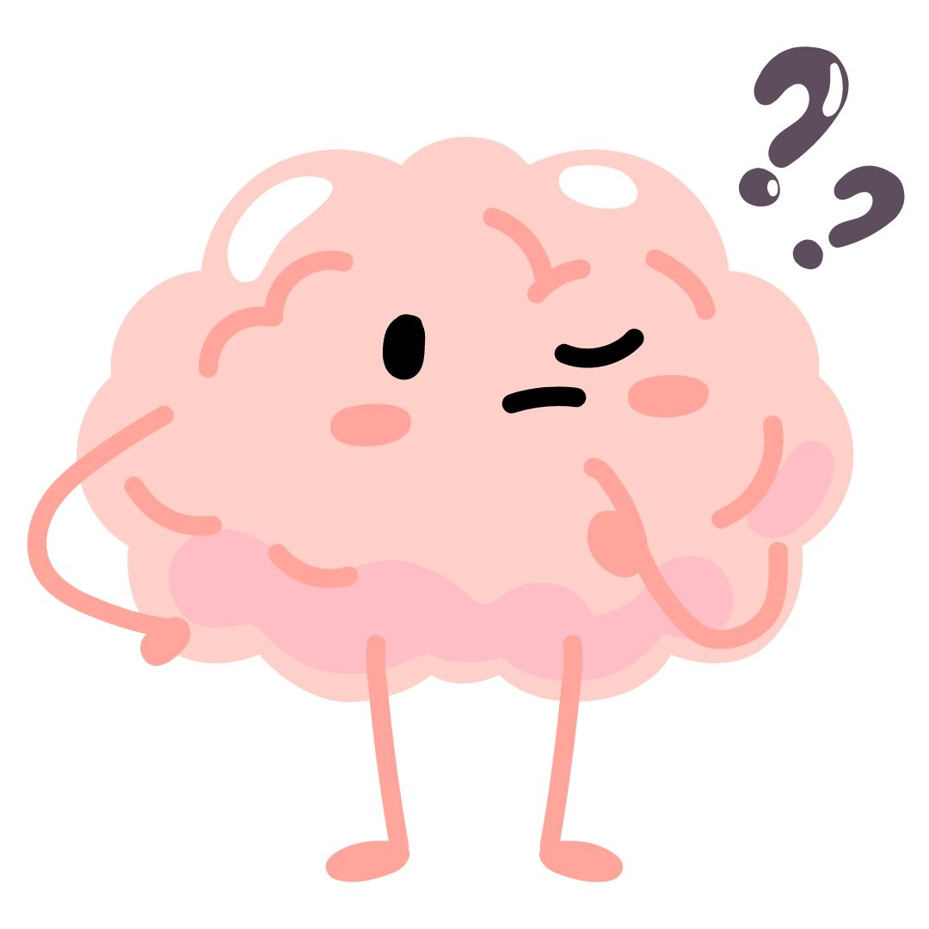
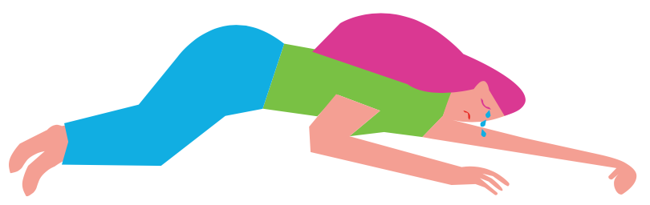
Activity 1: Loaded Language
If I told you that I was depressed, what do I mean?
What are some examples of situations in which a person might say they were depressed?
Notes:
Do:
Engage students in discussion about the idea of being “depressed."
Ask students questions such as:
If I told you that I was depressed, what do I mean?
Can you give me examples of situations in which a person might say they were depressed?
Student responses will likely focus around situations where they were sad, lonely, etc.
Ask:
If I told you that I was depressed, what do I mean?
Do:
Call on diverse voices to respond to the questions.
Ask:
What are some examples of situations in which a person might say they were depressed?
Do:
Call on diverse voice to respond to the questions and briefly summarize their responses.

Slide 7
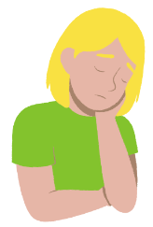
Activity 1: Loaded Language
depressed
adjective; exhibiting symptoms of a mood disorder marked especially by pervasive sadness, inactivity, difficulty in thinking and concentration, a significant increase or decrease in appetite and time spent sleeping, and feelings of dejection and hopelessness. Not a passing mood or feeling, but a mental illness.
Notes:
Do:
Share the following definition of the word depressed.
Ask students questions such as:
How does this definition fit with the examples you have given?
How might people respond to hearing that someone is depressed?
Is using the term “depressed” always accurate?
What other, more accurate terms could we use in situations where a person might say they felt depressed?
Do:
Draw students’ attention to personal experiences where they heard someone describing themselves as “depressed.”
Discuss whether (or under what circumstances) different vocabulary would provide a more accurate description of what is going on Discussion about depression may reveal student experiences of living with, or supporting a friend or family member who has a diagnosed depression. With this in mind, teachers should be sensitive to the particular needs of students impacted by a diagnosed depression during this activity.
Say:
Here is a definition for depression.
Ask:
Who would like to read this definition aloud to the class?
How does this definition fit with the examples you have given? Is using the term "depressed" always accurate? What other, more accurate terms could we use in situations where a person might say they felt depressed?
Student responses could include words and phrases such as: sad, lonely, disconnected, low-spirits, blue, etc.
Say:
Think about others in your life that have used the word "depressed" to describe how they were feeling. Were they actually "depressed" based on our definition or could other words have been used to more accurately describe how they were feeling? Nod your head "yes" or shake your head "no" to respond.
While we may not be feeling "depressed," feelings of sadness, loneliness, and disconnection can be tough to work through but they give us opportunities to practice helpful coping skills. These coping skills will be important throughout our lives so we're going to spend time learning about them as we work through The Guide.

Slide 8

Activity 2: The Power of Words
Notes:
Purpose of activity: Finding a correct emotional label for each graphic is not the point, instead the focus should be on building descriptive language that is a more accurate representation of the emotion or feeling.
Considerations: You have options for completing this task: 1) students can work independently to name the emotions and then share their ideas with the group, 2) students can work in groups to collaboratively name the emotions, or 3) Post enlarged versions of the emojis around the room and provide students with Post-it Notes to label each emotional emoji as they walk around the room, then regroup to discuss and narrow down the ideas.
Say:
The language used to represent an emotion or feeling experience can affect how it is perceived and responded to by the individual and others. Therefore, we are going to discuss "the power of words."
In the slides ahead, I am going to share different emojis with varying emotions. For each emoji, I am going to ask you all to come up with as many words as you can to describe the emotion shown.

Slide 9

Activity 2: The Power of Words
What emotion is this?
Notes:
Say: What emotion is shown on this slide?
Allow students to discuss and share their perspectives

Slide 10

Activity 2: The Power of Words
What emotion is this?
Notes:
Say: What emotion is shown on this slide?
Allow students to discuss and share their perspectives

Slide 11

Activity 2: The Power of Words
What emotion is this?
Notes:
Say: What emotion is shown on this slide?
Allow students to discuss and share their perspectives

Slide 12

Activity 2: The Power of Words
What emotion is this?
Notes:
Say: What emotion is shown on this slide?
Allow students to discuss and share their perspectives

Slide 13

Activity 2: The Power of Words
What emotion is this?
Notes:
Say: What emotion is shown on this slide?
Allow students to discuss and share their perspectives

Slide 14

Activity 2: The Power of Words
What emotion is this?
Notes:
Say: What emotion is shown on this slide?
Allow students to discuss and share their perspectives

Slide 15

Activity 2: The Power of Words
What emotion is this?
Notes:
Say: What emotion is shown on this slide?
Allow students to discuss and share their perspectives

Slide 16

Activity 2: The Power of Words
What emotion is this?
Notes:
Say: What emotion is shown on this slide?
Allow students to discuss and share their perspectives

Slide 17

Activity 2: The Power of Words
What emotion is this?
Notes:
Say: What emotion is shown on this slide?
Allow students to discuss and share their perspectives

Slide 18

Activity 2: The Power of Words
What emotion is this?
Notes:
Say: What emotion is shown on this slide?
Allow students to discuss and share their perspectives

Slide 19

Activity 2: The Power of Words
What emotion is this?
Notes:
Say: What emotion is shown on this slide?
Allow students to discuss and share their perspectives

Slide 20

Activity 2: The Power of Words
What emotion is this?
Notes:
Say: What emotion is shown on this slide?
Allow students to discuss and share their perspectives

Slide 21

Activity 2: The Power of Words
What emotion is this?
Notes:
Say: What emotion is shown on this slide?
Allow students to discuss and share their perspectives

Slide 22

Activity 2: The Power of Words
What emotion is this?
Notes:
Say: What emotion is shown on this slide?
Allow students to discuss and share their perspectives

Slide 23

Activity 2: The Power of Words
What emotion is this?
Notes:
Say: What emotion is shown on this slide?
Allow students to discuss and share their perspectives

Slide 24

Activity 2: The Power of Words
What emotion is this?
Notes:
Say: What emotion is shown on this slide?
Allow students to discuss and share their perspectives

Slide 25

Activity 2: The Power of Words
The Emotion Spectrum
Tolerable
Intolerable
Notes:
Prepare a long, double-ended arrow on the board or on poster paper. Ask students to consider this double-ended arrow as an “emotion spectrum,” with the left end representing a tolerable emotion (i.e., an emotion that they feel comfortable experiencing) and the right end representing an intolerable emotion (i.e., a very painful, difficult emotion to experience).
Which emotions are tolerable, intolerable, or in the middle?
Say:
We've named a lot of feelings words so far. Take a moment to independently write down as many of the feelings as you can remember. Of the emotions you wrote down or that we named, which are tolerable or easier to manage and deal with? Which emotions are intolerable and much harder to deal with?
Ask:
Let's begin with the tolerable emotions. Which are tolerable and where would you put them on this spectrum? Explain why you think it is tolerable. What happens if that feeling continues for a long-time? When does it move toward intolerable?
Ask:
OK, let's move to intolerable emotions. Which are intolerable and where would you put them on the spectrum? Explain why you think it is intolerable.
Say:
As you can tell from our discussion, there are a lot of feelings words that can be used to describe our experiences and some emotions are easier to deal with than others.

Slide 26
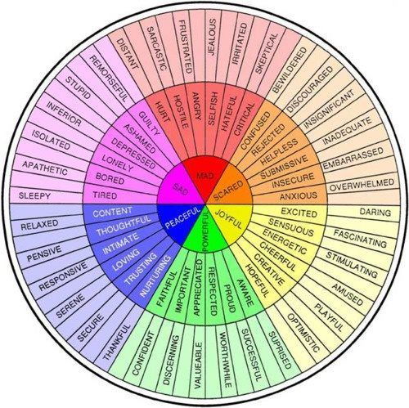
Activity 2: The Power of Words
What is the benefit of having a variety of words to describe our feelings or emotions?
How can increasing our emotional vocabulary help others to better understand our experiences?
Notes:
The purpose of this debriefing is to ask questions that guide students toward an understanding that broadening terminology can offer clarity and benefit them in times of need.
The intent of this activity is not to bring students into agreement, but rather to demonstrate that each of us can depict, respond and react differently to expressions of emotions
or feelings.
Say:
As we learned from discussing the spectrum on the last slide, there are many words we can use to describe our experiences. The feelings wheel on the right of this page also shows some of the words we discussed and more.
Ask:
What is the benefit of having a lot of different words to describe our emotions or feelings? \
Follow-up questions, if needed:
How do the words we use affect how people react to us?
How do the words we use affect how we think about ourselves?
How do the words we use affect how people help us with problems?
Say:
The amount of words we know of to describe our feelings or emotions is called our feelings vocabulary.
Ask:
How can increasing our feelings vocabulary help others to better understand our experiences?
Say:
The key point is that each of us can use our feelings vocabulary to accurately, and inaccurately, describe our experiences. Importantly, the words we use to describe our emotions and feelings will affect how others respond to and help us. The better you are at describing how you feel, the easier it will be to access the help you may need from friends, family members, and/or professionals.

Slide 27
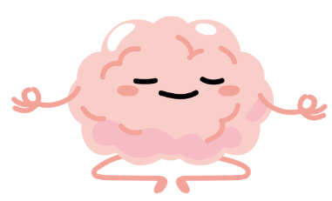
Activity 3: A Physical Analogy
Notes:
Purpose of activity: Introduce students to definitions of physical health and physical illness as an analogy that supports a conceptual understanding of mental health and mental illness. Conceptual connection: Everyone has mental health.
Considerations:
Say:
Activity III is a physical analogy.

Slide 28

Activity 3: A Physical Analogy
Independent Work:
Let’s Get Physical
Notes:
Do:
Distribute copies of student handout Let’s Get Physical and have students reflect on each of the statements, then identify whether they feel each one is true or false. This should be independent, formative work.
Say:
Let's take 5 minutes to complete this is an independent activity. Read each question and decide if it is true or false.
Once you are done, turn your paper over and put it to the side. We are going to revisit this worksheet in a few minutes and discuss our responses.

Slide 29
Activity 3: A Physical Analogy
We all have physical health. Physical health is how well our bodies function. For example, we might say we are physically fit or out of shape. These are ways of describing a person's physical health.
Can a person who has a physical condition requiring use of a wheelchair still be physically healthy? Yes! The individual requires physical supports for mobility, but if they eat well, exercise, and take care of their bodies they will maintain physical health.
A person may also experience a problem with their physical health that is temporary, for example, stumbling and twisting your ankle. This may affect your physical health, but doesn’t make you ill and may not require medical services.
Notes:
Say:
We are going to read a passage as a whole group and then discuss it together.
Ask:
Who would like to read the first paragraph? Second? Third?

Slide 30
Activity 3: A Physical Analogy
What is this passage saying?
How would you define physical health?
How would you define physical illness?
Notes:
Say:
You are going to work with your neighbor for 5-minutes to discuss the questions on this slide.
Start a 5-minute timer. When there are two minutes left, say "we have 2 minutes left" as a transitional warning.
Ask (once the timer goes off):
What is this passage saying?
How would you define physical health?
How would you define physical illness?
Have students work in groups to come up with two definitions, one for physical health and the other for physical illness. Share these definitions with the class. You are looking for definitions that reflect the content of the passage provided, where physical health is a person’s physical state of being and physical illness is when there is something significantly wrong with their physical health that would require medical intervention.
Have students look back at their copies of Let’s Get Physical and reconsider their responses, changing between “true” and “false” where they see fit. This should be collaborative work. Student responses should be shared to ensure the lesson ends with all students having the correct answers.

Slide 31
Activity 3: A Physical Analogy
What is this passage saying?
How would you define physical health?
How would you define physical illness?
Physical health is our physical state and how well our bodies function.
Physical illness is a physical condition that negatively affects how our bodies function and requires medical intervention.
Notes:
Say:
Physical health is our physical state and how well our bodies function. Physical illness is a physical condition that negatively affects how our bodies function and requires medical intervention.

Slide 32
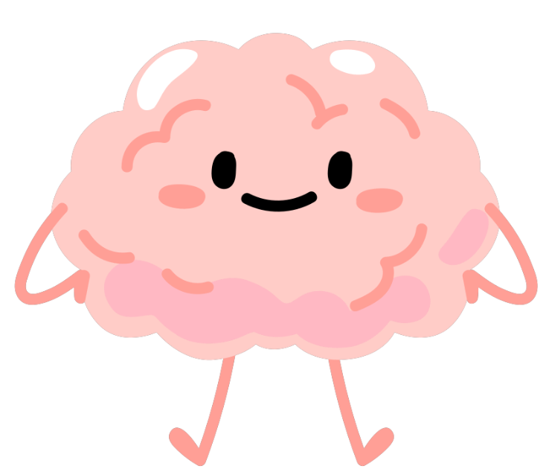
Activity 3: A Physical Analogy
Are all problems with physical health considered to be physical illnesses?
If I am "out of shape" and want to prevent it from becoming a physical illness (like diabetes or heart disease), what do I need to do?
Just like maintaining physical health requires intentional effort,
so does maintaining mental health.
Notes:
Ask:
Are all problems with physical health considered to be physical illnesses?
Ask:
If I am "out of shape" and want to prevent it from becoming a physical illness (like diabetes or heart disease), what must I do?
Say:
Just as maintaining physical health requires deliberate actions, so does maintaining mental health.

Slide 33

Activity 3: A Physical Analogy
Optional Extension:
Why we all need to practice emotional first aid.
Notes:
Have students work in groups to come up with two definitions, one for physical health and the other for physical illness. Share these definitions with the class. You are looking for definitions that reflect the content of the passage provided, where physical health is a person’s physical state of being and physical illness is when there is something significantly wrong with their physical health that would require medical intervention.
Have students look back at their copies of Let’s Get Physical and reconsider their responses, changing between “true” and “false” where they see fit. This should be collaborative work. Student responses should be shared to ensure the lesson ends with all students having the correct answers.

Slide 34
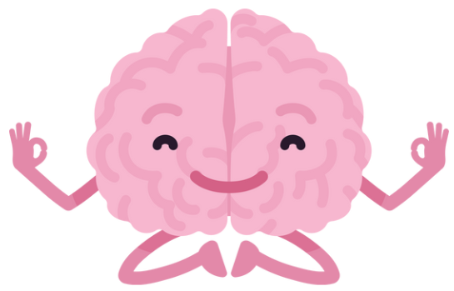
Activity 4: States of Mental Health
Notes:
Say:
Activity IV is going to teach us about the states of mental health. Just like we all have physical health, we all have mental health. And just like we must actively take care of our physical health, we must actively take care of our mental health to prevent or decrease severity of experiences with mental illness. As we prepare to take care of our mental health, it's helpful to understand the four categories of mental health.

Slide 35
Activity 4: States of Mental Health
mental health
NOUN
IS: the broad term we use to describe how we feel; which relates to our ability to live, learn, make decisions, cope with stress, and contribute
IS NOT: a bad mood, the lack of distress, or the lack of a diagnosis or disorder, like depression
How does this compare to our definition of physical health?
Notes:
Say:
Here is the definition of mental health. Read the definition.
Ask:
How does this compare to our definition of physical health? Summarize their ideas.

Slide 36
Activity 4: States of Mental Health
No Distress
Mental Distress
Mental Health Problem
Mental Illness
A person can be in one or more of these states at the same time.
Notes:
Say:
In this lesson, we describe four states of mental health. No distress, mental distress, mental health problems, and mental illness. A person can be in one or more of these states at the same time.

Slide 37
Activity 4: States of Mental Health
No distress is when a person is feeling at ease and balanced.
No Distress
Mental Distress
Mental Health Problem
Mental Illness
Which emotion words might be used by a person who is experiencing no distress?
Notes:
Do:
Read the slide
Say:
In the no distress category, we may experience emotions like happiness, bliss, joy, fun, cheerfulness, glee, satisfied, amused, enthusiastic, pleasure, excitement, passion, content.

Slide 38
Activity 4: States of Mental Health
Mental distress is the inner signal of stress experienced through the ups and downs of daily life. It is healthy, inevitable, and necessary for growth and development.
No Distress
Mental Distress
Mental Health Problem
Mental Illness
Which emotion words might be used by a person who is experiencing mental distress?
Notes:
Do:
Read slide
Say:
In the mental distress category, we may experience emotions like focus, sadness, frustration, nervousness, embarrassment, annoyed, insecure, loneliness, or stress

Slide 39
Activity 4: States of Mental Health
A mental health problem is when a person is faced with much greater stress than usual, and that stress causes changes to thoughts, feelings, and/or behaviors.
Example: grief from the loss of a close friend or relative
No Distress
Mental Distress
Mental Health Problem
Mental Illness
Which emotion words might be used by a person who is experiencing a mental health problem?
Notes:
Do:
Read the slide
Say:
In the mental health problem category, we may experience emotions like panic, shock, rage, unmotivated, rejected, hurt, weak, isolated, ashamed.

Slide 40
Activity 4: States of Mental Health
Mental illness is when a person experiences significant, substantial, and persistent problems with thoughts, feelings, and behaviors.
No Distress
Mental Distress
Mental Health Problem
Mental Illness
Which emotion words might be used by a person who is experiencing mental illness?
Notes:
Say:
In the mental illness category, we may experience emotions like paranoia, rejection, hopelessness, betrayal, hostility, irritability and, confusion consistently over a period of time. When we experience mental illness, it can be very challenging to escape, avoid, or cope with challenging feelings. However, when we can name how we feel and share with others, it allows us to get the help we need to cope with difficult emotions.
For example, if you're experiencing some of the emotions discussed, the adults that care for you can help or identify professionals with skills to diagnose and treat mental illness. Ultimately, mental illness is a medical condition diagnosed by trained health professionals using standard criteria. It is important to remember that when a person is diagnosed with a mental illness they do not lose their mental health.

Slide 41
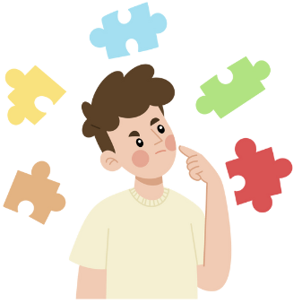
Activity 4: States of Mental Health
Are all problems with mental health considered to be mental illnesses?
Notes:
Ask:
Are all problems with mental health considered to be mental illness?
Ask:
How might it be possible to have mental health and mental illness at the same time?
Say:
Having problems with your mental health does not automatically mean you have a mental illness. For example, when you are stressed about a test that's coming up, it's normal to feel nervous or experience racing thoughts like "I hope I do well," "am I going to pass," and "what else do I need to study to be prepared?" If you do in fact have a mental illness, like depression, you still have mental health. For example, you can feel happiness and experience excitement during some moments while dealing with sadness in other moments.

Slide 42
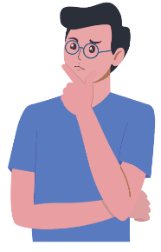

Activity 4: States of Mental Health
Optional: Sorting Activity
Notes:
Instructions:
Classify each example as either no distress, mental distress, a mental health problem or a mental illness.

Slide 43

Activity 4: States of Mental Health
Optional: Sorting Activity
Classify each example as either no distress, mental distress, a mental health problem or a mental illness.
Notes:
Directions:
Categorize each statement as a mental health state. Your options include no distress, mental distress, a mental health problem, or a mental disorder. Check-in with your classmates to see if they agree or disagree. Discuss as a group what is noticed. Note that some may fit into more than one category

Slide 44
Activity 4: States of Mental Health
Optional: Sorting Activity
After staying up late and not getting much sleep, a student has to get up and get to school on time.
Answer choices:
no distress
mental distress
mental health problem
mental illness
What is this an example of?
Notes:
Directions:
Categorize each statement as a mental health state. Your options include no distress, mental distress, a mental health problem, or a mental disorder. Check-in with your classmates to see if they agree or disagree. Discuss as a group what is noticed. Note that some may fit into more than one category

Slide 45
Activity 4: States of Mental Health
Optional: Sorting Activity
After staying up late and not getting much sleep, a student has to get up and get to school on time.
Answer choices:
no distress
mental distress
mental health problem
mental illness
Answer:
Mental Distress- Normal ups and downs necessary for growth and development
Notes:
Directions:
Categorize each statement as a mental health state. Your options include no distress, mental distress, a mental health problem, or a mental disorder. Check-in with your classmates to see if they agree or disagree. Discuss as a group what is noticed. Note that some may fit into more than one category

Slide 46
Activity 4: States of Mental Health
Optional: Sorting Activity
A student who prides themselves on getting top marks has a number of projects and tests, all due the same week, and asks for extensions.
Answer choices:
no distress
mental distress
mental health problem
mental illness
What is this an example of?
Notes:
Directions:
Categorize each statement as a mental health state. Your options include no distress, mental distress, a mental health problem, or a mental disorder. Check-in with your classmates to see if they agree or disagree. Discuss as a group what is noticed. Note that some may fit into more than one category

Slide 47
Activity 4: States of Mental Health
Optional: Sorting Activity
A student who prides themselves on getting top marks has a number of projects and tests, all due the same week, and asks for extensions.
Answer choices:
no distress
mental distress
mental health problem
mental illness
Answer:
Mental Distress- Normal ups and downs necessary for growth and development OR could be No Distress if they are handling it well and feeling at ease
Notes:
Directions:
Categorize each statement as a mental health state. Your options include no distress, mental distress, a mental health problem, or a mental disorder. Check-in with your classmates to see if they agree or disagree. Discuss as a group what is noticed. Note that some may fit into more than one category

Slide 48
Activity 4: States of Mental Health
Optional: Sorting Activity
A student’s parents have separated and started divorce proceedings, and she is struggling in the aftermath.
Answer choices:
no distress
mental distress
mental health problem
mental illness
What is this an example of?
Notes:
Directions:
Categorize each statement as a mental health state. Your options include no distress, mental distress, a mental health problem, or a mental disorder. Check-in with your classmates to see if they agree or disagree. Discuss as a group what is noticed. Note that some may fit into more than one category

Slide 49
Activity 4: States of Mental Health
Optional: Sorting Activity
A student’s parents have separated and started divorce proceedings, and she is struggling in the aftermath.
Answer choices:
no distress
mental distress
mental health problem
mental illness
Answer:
Mental Health Problem- This is greater stress than normal and she may be experiencing changes in thoughts, behaviors or feeling OR
Mental Distress- Normal ups and downs necessary for growth and development if she is not experiencing the changes
Notes:
Directions:
Categorize each statement as a mental health state. Your options include no distress, mental distress, a mental health problem, or a mental disorder. Check-in with your classmates to see if they agree or disagree. Discuss as a group what is noticed. Note that some may fit into more than one category

Slide 50
Activity 4: States of Mental Health
Optional: Sorting Activity
After speaking with a doctor and being referred to a psychologist for counseling, a student begins taking medication for depression.
Answer choices:
no distress
mental distress
mental health problem
mental illness
What is this an example of?
Notes:
Directions:
Categorize each statement as a mental health state. Your options include no distress, mental distress, a mental health problem, or a mental disorder. Check-in with your classmates to see if they agree or disagree. Discuss as a group what is noticed. Note that some may fit into more than one category

Slide 51
Activity 4: States of Mental Health
Optional: Sorting Activity
After speaking with a doctor and being referred to a psychologist for counseling, a student begins taking medication for depression.
Answer choices:
no distress
mental distress
mental health problem
mental illness
Answer:
Mental Illness- It has been diagnosed and treatment has begun.
Notes:
Directions:
Categorize each statement as a mental health state. Your options include no distress, mental distress, a mental health problem, or a mental disorder. Check-in with your classmates to see if they agree or disagree. Discuss as a group what is noticed. Note that some may fit into more than one category

Slide 52
Activity 4: States of Mental Health
Optional: Sorting Activity
Although this term at school has been tough, a student feels both relief that it’s over and pride that he got all of his assignments in on time.
Answer choices:
no distress
mental distress
mental health problem
mental illness
What is this an example of?
Notes:
Directions:
Categorize each statement as a mental health state. Your options include no distress, mental distress, a mental health problem, or a mental disorder. Check-in with your classmates to see if they agree or disagree. Discuss as a group what is noticed. Note that some may fit into more than one category

Slide 53
Activity 4: States of Mental Health
Optional: Sorting Activity
Although this term at school has been tough, a student feels both relief that it’s over and pride that he got all of his assignments in on time.
Answer choices:
no distress
mental distress
mental health problem
mental illness
Answer:
Mental Distress- normal ups and downs necessary for growth and development OR
No distress if he is handling it well and feeling at ease
Notes:
Directions:
Categorize each statement as a mental health state. Your options include no distress, mental distress, a mental health problem, or a mental disorder. Check-in with your classmates to see if they agree or disagree. Discuss as a group what is noticed. Note that some may fit into more than one category

Slide 54
Activity 4: States of Mental Health
Optional: Sorting Activity
A student is called down to the office and, although he doesn’t know why he’s been called down, he begins to sweat as he approaches the office.
Answer choices:
no distress
mental distress
mental health problem
mental illness
What is this an example of?
Notes:
Directions:
Categorize each statement as a mental health state. Your options include no distress, mental distress, a mental health problem, or a mental disorder. Check-in with your classmates to see if they agree or disagree. Discuss as a group what is noticed. Note that some may fit into more than one category

Slide 55
Activity 4: States of Mental Health
Optional: Sorting Activity
A student is called down to the office and, although he doesn’t know why he’s been called down, he begins to sweat as he approaches the office.
Answer choices:
no distress
mental distress
mental health problem
mental illness
Answer:
Mental Distress- normal ups and downs necessary for growth and development
Notes:
Directions:
Categorize each statement as a mental health state. Your options include no distress, mental distress, a mental health problem, or a mental disorder. Check-in with your classmates to see if they agree or disagree. Discuss as a group what is noticed. Note that some may fit into more than one category

Slide 56
Activity 4: States of Mental Health
Optional: Sorting Activity
A student who has struggled for months with feelings of hopelessness and worthlessness begins to have recurring thoughts of suicide.
Answer choices:
no distress
mental distress
mental health problem
mental illness
What is this an example of?
Notes:
Directions:
Categorize each statement as a mental health state. Your options include no distress, mental distress, a mental health problem, or a mental disorder. Check-in with your classmates to see if they agree or disagree. Discuss as a group what is noticed. Note that some may fit into more than one category

Slide 57
Activity 4: States of Mental Health
Optional: Sorting Activity
A student who has struggled for months with feelings of hopelessness and worthlessness begins to have recurring thoughts of suicide.
Answer choices:
no distress
mental distress
mental health problem
mental illness
Answer:
Mental Illness- Significant, substantial, and persistent problems with thoughts, feelings, or behavior
Notes:
Directions:
Categorize each statement as a mental health state. Your options include no distress, mental distress, a mental health problem, or a mental disorder. Check-in with your classmates to see if they agree or disagree. Discuss as a group what is noticed. Note that some may fit into more than one category

Slide 58
Activity 4: States of Mental Health
Optional: Sorting Activity
A student desperately wants to make it onto one of the school’s sports teams but worries that they don’t have what it takes to play at that level.
Answer choices:
no distress
mental distress
mental health problem
mental illness
What is this an example of?
Notes:
Directions:
Categorize each statement as a mental health state. Your options include no distress, mental distress, a mental health problem, or a mental disorder. Check-in with your classmates to see if they agree or disagree. Discuss as a group what is noticed. Note that some may fit into more than one category

Slide 59
Activity 4: States of Mental Health
Optional: Sorting Activity
A student desperately wants to make it onto one of the school’s sports teams but worries that they don’t have what it takes to play at that level.
Answer choices:
no distress
mental distress
mental health problem
mental illness
Answer:
Mental Distress- Normal ups and downs necessary for growth and development
Notes:
Directions:
Categorize each statement as a mental health state. Your options include no distress, mental distress, a mental health problem, or a mental disorder. Check-in with your classmates to see if they agree or disagree. Discuss as a group what is noticed. Note that some may fit into more than one category

Slide 60
Activity 4: States of Mental Health
Optional: Sorting Activity
After breaking up with his girlfriend, a student feels uncomfortable in their shared social group and begins to avoid going to school.
Answer choices:
no distress
mental distress
mental health problem
mental illness
What is this an example of?
Notes:
Directions:
Categorize each statement as a mental health state. Your options include no distress, mental distress, a mental health problem, or a mental disorder. Check-in with your classmates to see if they agree or disagree. Discuss as a group what is noticed. Note that some may fit into more than one category

Slide 61
Activity 4: States of Mental Health
Optional: Sorting Activity
After breaking up with his girlfriend, a student feels uncomfortable in their shared social group and begins to avoid going to school.
Answer choices:
no distress
mental distress
mental health problem
mental illness
Answer:
Mental Health Problem- This is greater stress than normal and he is experiencing changes in thoughts, feelings and behaviors
Notes:
Directions:
Categorize each statement as a mental health state. Your options include no distress, mental distress, a mental health problem, or a mental disorder. Check-in with your classmates to see if they agree or disagree. Discuss as a group what is noticed. Note that some may fit into more than one category

Slide 62
Activity 4: States of Mental Health
Optional: Sorting Activity
A student is required to give a speech in front of the class as part of her final project, and just the thought of it gives her butterflies in her stomach.
Answer choices:
no distress
mental distress
mental health problem
mental illness
What is this an example of?
Notes:
Directions:
Categorize each statement as a mental health state. Your options include no distress, mental distress, a mental health problem, or a mental disorder. Check-in with your classmates to see if they agree or disagree. Discuss as a group what is noticed. Note that some may fit into more than one category

Slide 63
Activity 4: States of Mental Health
Optional: Sorting Activity
A student is required to give a speech in front of the class as part of her final project, and just the thought of it gives her butterflies in her stomach.
Answer choices:
no distress
mental distress
mental health problem
mental illness
Answer:
Mental Distress- Normal ups and downs necessary for growth and development
Notes:
Directions:
Categorize each statement as a mental health state. Your options include no distress, mental distress, a mental health problem, or a mental disorder. Check-in with your classmates to see if they agree or disagree. Discuss as a group what is noticed. Note that some may fit into more than one category

Slide 64
Activity 4: States of Mental Health
Optional: Sorting Activity
A student takes on an extra class and uses time management strategies to make sure they can handle the extra workload.
Answer choices:
no distress
mental distress
mental health problem
mental illness
What is this an example of?
Notes:
Directions:
Categorize each statement as a mental health state. Your options include no distress, mental distress, a mental health problem, or a mental disorder. Check-in with your classmates to see if they agree or disagree. Discuss as a group what is noticed. Note that some may fit into more than one category

Slide 65
Activity 4: States of Mental Health
Optional: Sorting Activity
A student takes on an extra class and uses time management strategies to make sure they can handle the extra workload.
Answer choices:
no distress
mental distress
mental health problem
mental illness
Answer:
Mental Distress- Normal ups and Downs necessary for growth and development OR
No Distress if they are handling it well and feeling at ease
Notes:
Directions:
Categorize each statement as a mental health state. Your options include no distress, mental distress, a mental health problem, or a mental disorder. Check-in with your classmates to see if they agree or disagree. Discuss as a group what is noticed. Note that some may fit into more than one category

Slide 66
Activity 4: States of Mental Health
Optional: Sorting Activity
A student’s grandmother, his primary caregiver, passes away and he still feels sad weeks later.
Answer choices:
no distress
mental distress
mental health problem
mental illness
What is this an example of?
Notes:
Directions:
Categorize each statement as a mental health state. Your options include no distress, mental distress, a mental health problem, or a mental disorder. Check-in with your classmates to see if they agree or disagree. Discuss as a group what is noticed. Note that some may fit into more than one category

Slide 67
Activity 4: States of Mental Health
Optional: Sorting Activity
A student’s grandmother, his primary caregiver, passes away and he still feels sad weeks later.
Answer choices:
no distress
mental distress
mental health problem
mental illness
Answer:
Mental Health Problem- This is greater stress than normal and he is experiencing changes in thoughts, feeling and behaviors
Notes:
Directions:
Categorize each statement as a mental health state. Your options include no distress, mental distress, a mental health problem, or a mental disorder. Check-in with your classmates to see if they agree or disagree. Discuss as a group what is noticed. Note that some may fit into more than one category

Slide 68
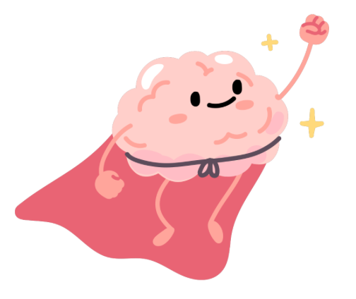
Activity 4: States of Mental Health
Key Points
Mental health describes a wide range of mental states including mental illness.
Having a mental health problem is not the same as having a mental illness.
Notes:
Directions:
Categorize each statement as a mental health state. Your options include no distress, mental distress, a mental health problem, or a mental disorder. Check-in with your classmates to see if they agree or disagree. Discuss as a group what is noticed. Note that some may fit into more than one category

Slide 69

Activity 5: Conceptual Understanding

Slide 70
Activity 5: Conceptual Understanding
Demonstrate your understanding of two or more conceptual connections addressed in this topic:
Everyone has mental health
Mental health describes a wide range of mental states including mental illness
Having a mental health problem is not the same as having a mental illness
The language used to represent an emotional experience can affect how it is perceived and responded to by self and others
How could your conceptual understanding be applied to a real life example?
If this school had a news station, how would you share the information we just covered?
What would be included on a website about the topic?
How would you share about the topic on social media?
How could you use art to share information about the topic?
Notes:
Say:
We covered a lot today. Choose an activity above to represent what you learned. This should be fun. You have an option to participate in one of the creative activities shown on the slide to illustrate your understanding of the key concepts we talked about today
Ask:
What were some takeaways for you today?
Do:
Pass out materials and provide an example of an activity the students can do
Conceptual Connections:
Everyone has mental health
Mental health describes a wide range of mental states including mental illness
Having a mental health problem is not the same as having a mental illness
The language used to represent an emotional experience can affect how it is perceived and responded to by self and others
How could your conceptual understanding be applied to a real life example?
If this school had a news station…how would you share the information we just covered?
What would be included on a website about the topic?
How would you share about the topic on social media?
How could you use art to share information about the topic?

Slide 71

Topic A: Questions?
Important reminders!
  The teachers and staff at [insert school] are here to help you. It's normal to need to ask for help sometimes.
  The mental health workers in your school are:
    [Name mental health professionals]
  If you or a friend would like to talk to someone about your mental health please see one of the mental health team members at your school or let your teacher know. They can connect you with the best person to help.
Notes:
Add your names!
It may be a good idea to give out referrals!

Slide 72

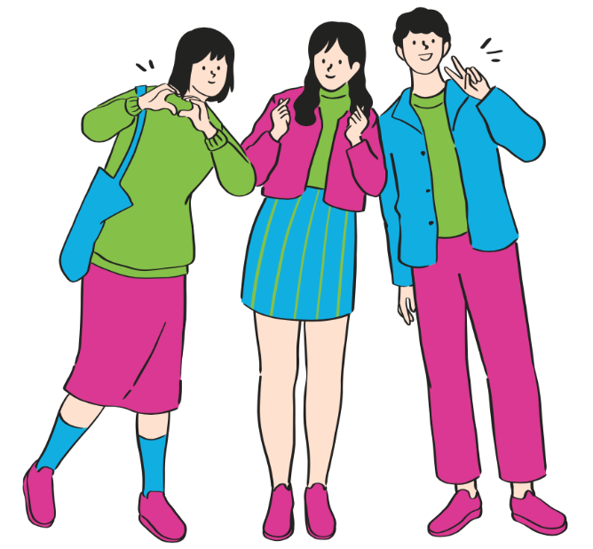


Connect and Learn More!
@MHLiteracy
www.mentalhealthliteracy.org
@MHLiteracy
Notes:
If students wish to access more information use this slide to direct them to teementalhealth.org.

