Slide 1

The Guide
Understanding Mental Health
and Mental Illness

Slide 2
Table of Contents
Topic A: What is mental health?
Topic B: How is the brain involved in mental health?
Topic C: What is stigma?
Topic D: How can a person find support?
Topic E: How can positive mental health be maintained?
Notes:
Introduce topics and purpose of program
SAY: Today we will learn about how we can care for our mental health and how we can respond to stressful or difficult events.

Slide 3

Topic E:
How can Positive Mental Health be Maintained?
[Insert teacher / facilitator name]

Slide 4





Topic E: How can Positive Mental Health be Maintained?
Activity 1:
Finding and Creating your Happy Place
Activity 2:
Guided and Relaxed Breathing
Activity 3:
Box Breathing
Activity 4:
Progressive Muscle Relaxation
Activity 5:
Strategies for Maintaining Positive Mental Health
Notes:
Say:
All topics also have activities that will help us to learn more. Topic E has five activities that are listed here. Let's get started with Activity I: Finding and Creating your Happy Place
Do:
Provide agenda of what Topic E will cover (this slide)
Ask:
“Any questions before we get started?

Slide 5

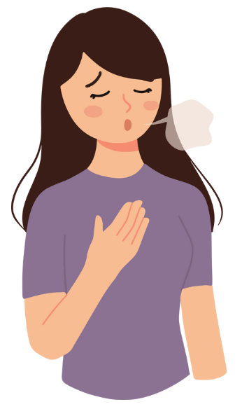
What is Stress?
Distress is stress that negatively affects you.
Eustress is stress that has a positive effect on you.
Notes:
Say:
Stress is a common feeling we get when we feel under pressure. A small amount can be good and motivate as to meet our goals. But too much stress, when it feels out of control, can impact our mood, our wellbeing, our relationships with people around us. Stress | The Children's Society (childrenssociety.org.uk) Managing Stress | NAMI: National Alliance on Mental Illness. Define/clarify eustress (good/motivator) /distress (negative/harmful) for students.
Ask:
Have you ever felt “stressed”? What causes you to stress out?

Slide 6
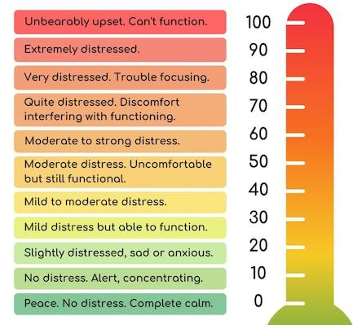
Think – Pair – Share
How do you know that your stress level is high?
What are your personal stress signs?
Notes:
Do:
Think – Pair – Share: Have students find a partner or assign partners. Students should discuss: How do you know that your stress level is high? What are your personal stress signs? Add picture of thermometer (include these instructions on the slide – so the PPT is focused on the activity)

Slide 7

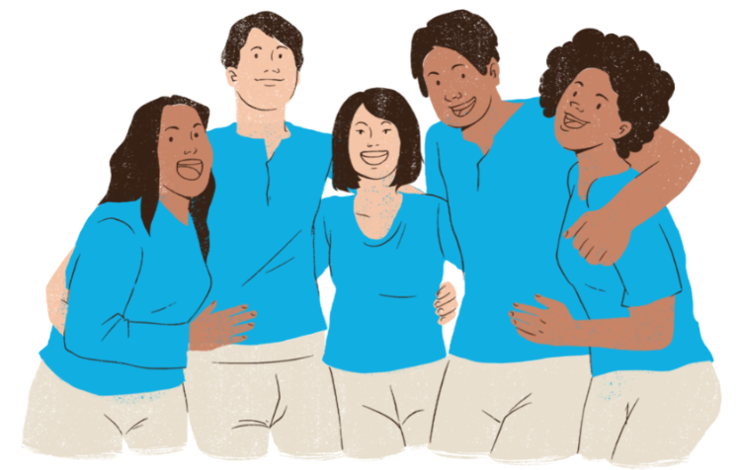
Activity 1:
Finding and Creating your Happy Place

Slide 8
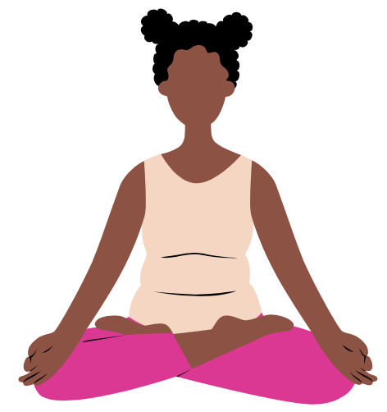
Finding and Creating your Happy Place
This place can be real or imaginary
This place is somewhere where you feel calm, happy, and safe
Use all your senses to create a strong image in your mind
  What do you see?
  What do you hear?
  What can you smell?
  What do you taste?
  What do you feel?
Notes:
Pre-work:
Gather enough poster boards for each student and collect magazines that students can use for their artwork.
Minimum materials: (or paper, pencil, crayons)
(create an intro slide that outlines all pre-work/activity for this Topic)
Ask:
By a show of hands, who has ever heard of a happy place?
Say:
A happy place can be real or imaginary – we can go to our happy place to feel calm, happy, and safe. When creating your happy place, engage all your senses - think of the things you see, hear, smell, taste, and feel. You can return to this place to relax no matter where you are!
As you create your happy place, think about when you can actually use it or return to it.
Examples: your happy place can be the mountains, the beach, or a made-up place that feels calm and safe.
Do:
Create a visual representation of your happy place – pass out art materials for the lesson.
(Students can use a blank poster board and magazines to visualize their happy places)

Slide 9
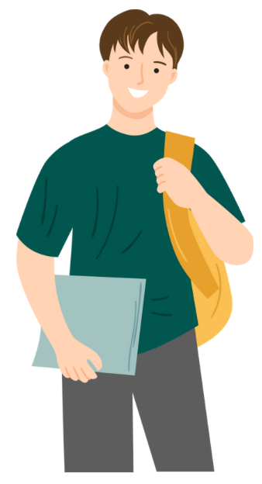
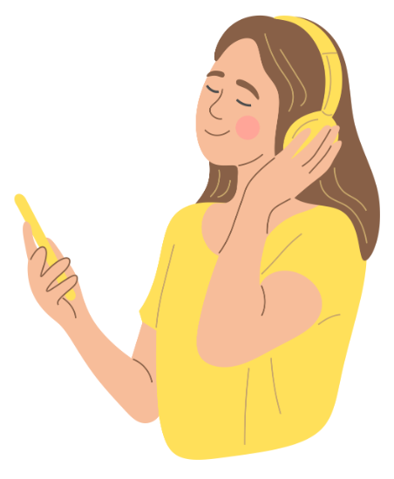

Finding and Creating your Happy Place
Get creative and create a visual representation of your Happy Place!
  Use any materials you have
  Paper, pencil, crayons, markers
  Magazines, scissors, glue, tape
Notes:
If you are supplying magazines, please ensure magazines are representative and reflective of the interests, identities, and cultural references of diverse students.

Slide 10
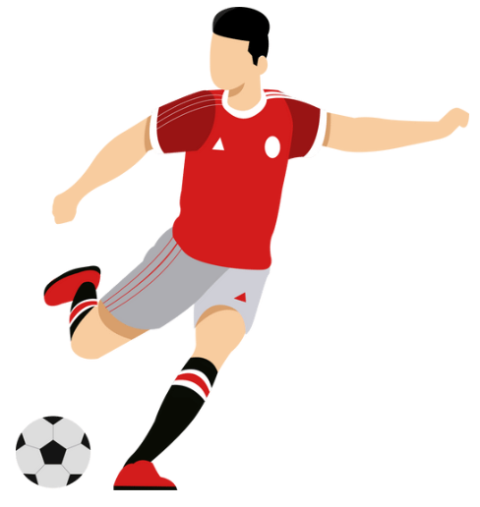
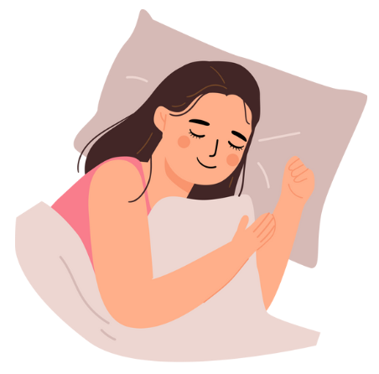

Finding and Creating your Happy Place
Show and tell us about your Happy Place!
Notes:
Facilitator Note – be prepared to show-and-tell your own happy place with students. This works for your own self care too ☺
Ask:
Who would like to share more about their happy place? Tell us (1) where/what it is and (2) when you can use it.
Do:
Have students show-and-tell their happy place with the class or in small groups.
Next step – create a bulletin board of all the happy places and keep in a “calming corner” in your classroom

Slide 11
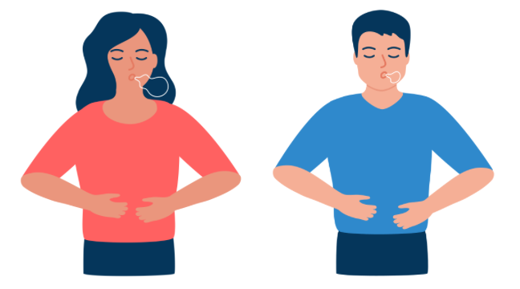
Activity 2: Guided Relaxed Breathing

Slide 12


Activity 2: Guided Relaxed Breathing
  Practice the Steps:
  Breathe in through your nose
  Breathe out through your mouth
  Pay attention to you breaths as they inhale and exhale in a pattern, focusing on the rise and fall of the chest or the sensation of air through the nostrils
Notes:
Say:
Guided breathing is a strategy we can use when we are feeling stressed. The point is to clear one’s mind and focus on physical sensations and, in doing so, bring one’s body into a more relaxed state.
Here is a video that can help us breathe deeply when we are feeling overwhelmed.
Do:
Play and watch the video https://www.youtube.com/watch?v=gLbK0o9Bk7Q (Relaxed Breathing)
Afterwards, ask:
What stood out to you? Have you done this type of breathing before? Did it help, why or why not?

Slide 13
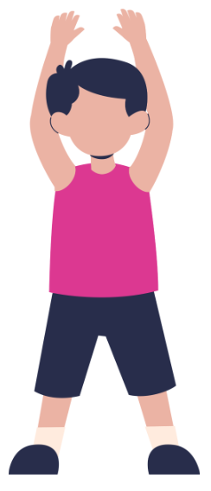
Activity 2: Guided Relaxed Breathing
Step 1: Complete 20-seconds of jumping jacks
Step 2: Notice and share any changes in your body
Notes:
If you have extra time for an activity:
Say:
For the next activity, we will need two volunteers. Ask volunteers to do jumping jacks for 20-seconds.
Have the other students clap and cheer the students on as the volunteers do the jumping jacks.
Ask the volunteers:
What changes do you notice in your body? (Examples: breathing quickly, feeling hot, sweating, heart racing, etc.)
Say:
These feelings are like what we feel in flight-fight-freeze response when we feel stressed.
The amygdala triggers this response in our brain.
Guided relaxed breathing like what we just practiced can help us feel calm when our bodies are stressed and feeling this way.

Slide 14

Activity 3: Box Breathing

Slide 15
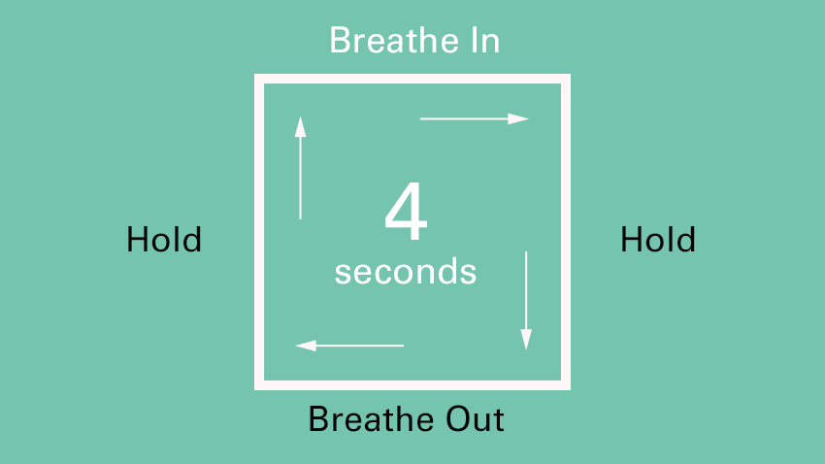
Box Breathing
Notes:
Do:
Play and watch the video - Link for Guided Box Breathing exercise https://www.youtube.com/watch?v=YFdZXwE6fRE (Box Breathing)
Afterwards, ask:
What stood out to you? Have you done this type of breathing before? Did it help, why or why not?
In case, there are internet issues:
How to do Box Breathing
Step 1: Breathe in, counting to four slowly. Feel the air enter your lungs.
Step 2: Hold your breath for 4 seconds. Try to avoid inhaling or exhaling for 4 seconds.
Step 3: Slowly exhale through your mouth for 4 seconds.
Step 4: Repeat steps 1 to 3 until you feel re-centered.

Slide 16
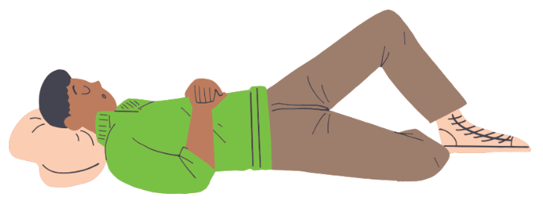
Activity 4: Progressive Muscle Relaxation

Slide 17
Activity 4: Progressive Muscle Relaxation
This is a strategy aimed at helping a person to physically relax when they are feeling anxious, stressed, or angry.
It is known to address physical problems such as stomachaches and headaches, as well as to improve sleep.
The technique involves tensing and then relaxing different muscles in the body, in turn.
This can help a person feel the difference between being in a state of physical tension or relaxation and to make connections between their mind and body.
Notes:
https://youtu.be/GZ9PHsbt-m4?si=kBXehiUjK3vDIrka
The link is for the stretching script which can be read below:
SAY:
(use language on the slide to introduce progressive muscle relaxation).
Now we will practice an activity called “progressive muscle relaxation” – we can use this when we have stomach aches and headaches and even when we just can’t sleep.
If video is not working – read script:
*Note for speaker – Be sure to pause between each sentence, and maintain a calm tone. If there are distractions, don’t worry! Simply reinforce the importance of PMR during stressful/chaotic moments.
Everyone get ready… (read the following script)
"Take a deep breath in through your nose...hold your breath for a few seconds…and now breathe out...good...take another deep breath through your nose…imagine your tummy is a big balloon filling up with air…hold your breath...now breathe out and imagine that the air in the balloon is slowly escaping...Now I want you to pay attention to your body and how your it feels...
Let’s start with your legs...I want you to stretch out your legs in front of you and point your toes...squeeze the muscles in the top of your legs...now squeeze the muscles in the bottom of your legs...hold it...now relax...let your legs go limp…imagine that your legs are floppy cooked spaghetti noodles...relax all the muscles in your legs...notice how heavy your legs feel...now take a deep breath and hold…and breathe out...
Now, make a fist with your left hand and squeeze...imagine that you are holding an orange and you are squeezing all the juice out of the orange...feel the tightness in your hand and arm...hold it tight...and now relax your hand...notice how your muscles feel when they are relaxed…now make a fist with your right hand and squeeze tight...imagine that your holding a lemon and squeeze all the juice out...feel the tightness in your hand and arm...hold it...and now relax your hand...enjoy feeling relaxed...now take a deep breath and hold...and breathe out...
Let’s focus on your arms…stretch your arms out in front of you like you are reaching out to something...keep stretching...hold it...and now relax...let your arms drop to your sides...imagine your arms are cooked spaghetti noodles that are dangling at your sides...notice how relaxed your arms feel...relax your arms...now stretch your arms up above your head...try to reach for the clouds with your finger tips...hold...keep reaching above your head...now let your arms drop to your sides...relax you arms…let your arms go very floppy...notice how calm you feel...now take a deep breath and hold...and breathe out...
Let’s move to your shoulder...pull your shoulders up to your ears...hold...keep holding...now relax...notice how relaxed you feel...now take a deep breath and hold...and breathe out...
Now, pull in your tummy muscles...imagine that an elephant has just stepped on your tummy...suck in all the muscles in your tummy...hold it...good...now relax...let your stomach out...relax all the muscles in your tummy...notice how your muscles feel when you relax them...now take a deep breath and hold...and breathe out...
Finally, wrinkle up your faces as much as you can...wrinkle your nose...mouth...eyes...forehead...cheeks...and push your lips together...Notice how tight the muscles in your face feel...hold it...good...now relax...let all the muscles in your face go limp...notice how relaxed you feel...now take a deep breath and hold...and breathe out...
Now relax your whole body…imagine you’re a rag doll and try and relax all the muscles in your body. Notice how good you feel...so relaxed...so calm...now take a deep breath and hold it...and breathe out...you’ve done very well! When you are ready, you can slowly open your eyes."

Slide 18
Share Out!
What are some things you already do to stay healthy and well?
Let’s make a list!
Notes:
Do:
Identify and discuss variety of strategies. Elicit feedback from students for other strategies not listed.
Say:
Now that we’ve went over a few strategies (visualizing a happy place, box breathing, relaxation breathing, PMR) – what are some other things you do to stay healthy and well?

Slide 19

Activity 5: Strategies for Maintaining Positive Mental Health

Slide 20
Strategies for Maintaining
Positive Mental Health
Relaxation Techniques like deep breathing, progressive muscle relaxation, and guided imagery | Maintaining physical health through healthy nutrition, sleep, and exercise habits | Building healthy relationships with family and friends
Notes:
Do:
Identify and discuss variety of strategies. Elicit feedback from students for other strategies not listed.
Say:
*Ask for student volunteers to read each one* - Would someone like to volunteer to read the strategies listed?
Ask:
What activities on this slide might be the most helpful for you?
Which ones have you never tried before but would like to?

Slide 21
Strategies for Maintaining
Positive Mental Health
Using Apps such as Calm, Virtual Hope Box, and others | Stress-coping activities such as yoga, listening to music, journaling, and drawing | Positive self-statements such as encouraging thoughts and affirmations
Notes:
Do:
Identify and discuss variety of strategies. Elicit feedback from students for other strategies not listed.
Say:
Here are more strategies we can do to maintain positive mental health. Ask for student volunteers to read each one.
Ask:
What activities on this slide might be the most helpful for you?
Which ones have you never tried before but would like to?

Slide 22






Check out these FREE apps for
Positive Mental Health
Notes:
Do:
Identify and discuss variety of strategies. Elicit feedback from students for other strategies not listed.
Say:
Here are some apps that are available to help with mental health.
Finch: Self Care Pet – on this app, you can meet your new self care best friend! Finch is a self care pet app that helps you feel prepared and positive, one day at a time. Take care of your pet by taking care of yourself! Choose from a wide variety of self care exercises personalized for you
Smiling Mind – on this app, you can practice your daily meditation and mindfulness exercises from any device
CBT Thought Diary – on this app, you can track your mood and identify patterns over time.
Wysa – Wysa is an emotionally intelligent chatbot that uses AI to react to the emotions you express
Mindshift - MindShift® CBT uses scientifically proven strategies based on Cognitive Behavioural Therapy (CBT) to help you learn to relax and be mindful, develop more effective ways of thinking, and use active steps to take charge of your anxiety.
Moodfit - Moodfit is an app that aims to helps you understand and improve their moods, increase resilience, and accomplish goals.
Ask:
Has anyone ever heard of these?
What other apps have you all used?

Slide 23
Strategies for Maintaining
Positive Mental Health
Setting Goals | Prioritizing tasks and staying organized
Notes:
Do:
Identify and discuss variety of strategies. Elicit feedback from students for other strategies not listed.
Say:
Staying organized also helps us maintain positive mental health.
Ask:
What activities on this slide might be the most helpful for you?
Which ones have you never tried before but would like to?

Slide 24
Conceptual Understanding
Show your understanding of two or more conceptual connections addressed in this topic:
  Positive mental health can be maintained using a number of strategies
  Stress can be beneficial and can be managed
  Different people cope with stress in different ways
  It is important to practice coping skills during times that you are not stressed
How could your conceptual understanding be applied to a real-life example?
  If our school had a news station, how would you share the information we just covered?
  What would be included on a website about the topic?
  How would you share about the topic on social media?
  How could you use art to share information about the topic?
Notes:
Say:
We covered a lot today. Choose an activity above to represent what you learned today.
This should be fun. You have an option to participate in one of the creative activities shown on the slide to illustrate your understanding of the key concepts we talked about today
Ask:
What were some takeaways for you today?
Do:
Pass out materials and provide an example of an activity the students can do
Conceptual Connections:
Positive mental health can be maintained using a number of strategies
Stress can be beneficial and can be managed
Different people cope with stress in different ways
It is important to practice coping skills during times that you are not stressed
Ask:
If this school had a news station…how would you share the information we just covered?
What would be included on a website about the topic?
How would you share about the topic on social media?
How could you use art to share information about the topic?

Slide 25
Overview of All Sessions
Topic A: What is mental health?
Topic B: How is the brain involved in mental health?
Topic C: What is stigma?
Topic D: How can a person find support?
Topic E: How can positive mental health be maintained?
Notes:
SAY: Now, we have completed the last session of The Guide. Let's do a quick overview of everything we learned.

Slide 26
Let’s Check Your Mental Health Knowledge!
Which is the correct definition of mental health?
Mental health is experienced through emotional, behavioral, physical, cognitive and social functions that enable us to feel, think and act in ways that enhance our ability to enjoy life and deal with challenges.
Mental health is when you never have bad moods.
Mental health is something that only some people have
Notes:
Which is the correct definition of Mental Health?
Mental health is experienced through emotional, behavioral, physical, cognitive and social functions that enable us to feel, think and act in ways that enhance our ability to enjoy life and deal with challenges. (CORRECT)
Mental health is when you never have bad moods.
Mental health is something that only some people have.

Slide 27
Let’s Check Your Mental Health Knowledge!
Which is the correct definition of mental illness?
Mental illness is when someone loses their mental health.
Mental Illness is a medical condition diagnosed by trained health professional using internationally established diagnostic criteria.
Mental illness means you can never enjoy life.
Notes:
Which is the correct definition of Mental Illness?
Mental illness is when someone loses their mental health.
Mental Illness is a medical condition diagnosed by trained health professional using internationally established diagnostic criteria. (CORRECT)
Mental illness means you can never enjoy life.

Slide 28
Let’s Check Your Mental Health Knowledge!
Stigma can make it harder for people to seek help and participate in treatment.
True
False
Be ready to explain your answer!
Notes:
True or False: Stigma can make it harder for people seek help and participate in treatment
True (CORRECT)
False

Slide 29
Let’s Check Your Mental Health Knowledge!
Finish this statement:
Stigma and discrimination are related because…
When stigma goes down, discrimination goes up
Stigma can lead to discrimination, which impacts how people interpret mental health and symptoms of mental illness and how people view getting help.
Neither - stigma and discrimination are not related
Notes:
7. Finish this statement: Stigma and discrimination are related because…
When stigma goes down, discrimination goes up.
Stigma and discrimination are not related.
Stigma can lead to discrimination (the unjust or prejudicial treatment of different categories of people), which impacts how people interpret mental health and symptoms of mental illness, and how they view getting help from mental health professionals and participating in treatment (CORRECT)

Slide 30
Let’s Check Your Mental Health Knowledge!
Which is the correct Crisis Help number (like 911 but for mental health emergencies)?
111
988
188
Notes:
8. Which the correct Crisis Help Number?
111
988 (CORRECT)
188

Slide 31
Let’s Check Your Mental Health Knowledge!
Which is true about consent?
People give and have consent when everyone involved in a situation have the freedom to decide whether they are interested in what is going on.
Consent is not important in healthy relationships. It is important to have one person in control of everything.
Consent is only about physical touching.
Notes:
9. Which is true about consent?
People give and have consent when everyone involved in the matter have the freedom to decide at any moment that are or are not or are no longer interested in what is going on. (CORRECT)
Consent is not important in healthy relationships.
Consent is only about touching.

Slide 32
Let’s Check Your Mental Health Knowledge!
Your relationships with your family shape the way your brain recognizes and understands relationships with others.
True
False
Be ready to explain your answer!
Notes:
10. True or False: Your relationships with your family shape the way your brain recognizes and understands relationships with others.
True (CORRECT)
False

Slide 33
Let’s Check Your Mental Health Knowledge!
It is never too late to ask for help.
True
False
Be ready to explain your answer!
Notes:
11. True or False: It is never too late to ask for help.
True (CORRECT)
False

Slide 34
Let’s Check Your Mental Health Knowledge!
Which is a good question to ask your therapist / counselor?
What is my diagnosis?
What is your approach to treatment and how do you think it will help me?
Both of the above questions are good to ask.
Notes:
12. Which is a good question you should ask your therapist?
What is my diagnosis?
What is your approach to treatment and how do you think it will help me?
Both are good questions to ask your therapist (CORRECT)

Slide 35
Let’s Check Your Mental Health Knowledge!
Distress is stress that negatively affects you; and Eustress is stress that has a positive effect on you.
True
False
BONUS: Give one example of each type of stress.
Notes:
13. True or False: Distress is stress that negatively affects you and Eustress is stress that has a positive effect on you.
True (CORRECT)
False

Slide 36
CERTIFICATE OF ACHIEVEMENT
This acknowledges that
[STUDENT NAME]
has successfully completed the Guide: Mental Health Literacy Curriculum
Instructor
Date

Slide 37

Topic E: Questions?
Important reminders!
  The teachers and staff at [insert school] are here to help you. It’s normal to need to ask for help sometimes.
  The mental health workers in your school are:
    [Name mental health professionals]
  If you or a friend would like to talk to someone about your mental health, please see one of the mental health team members at your school or let your teacher know. They can connect you with the best person to help.
Notes:
Add your names!
It may be a good idea to give out referrals!
Personalize this slide for your program/agency/school.

Slide 38

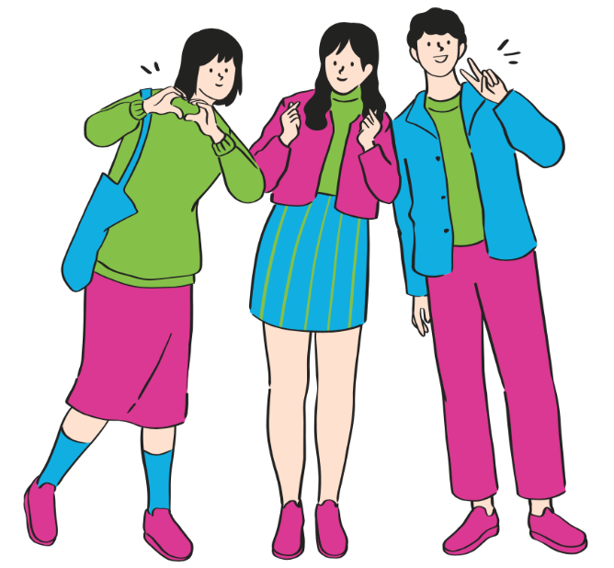


Connect and Learn More!
@MHLiteracy
www.mentalhealthliteracy.org
@MHLiteracy
Notes:
If students wish to access more information use this slide to direct them to teementalhealth.org.

