Slide 1
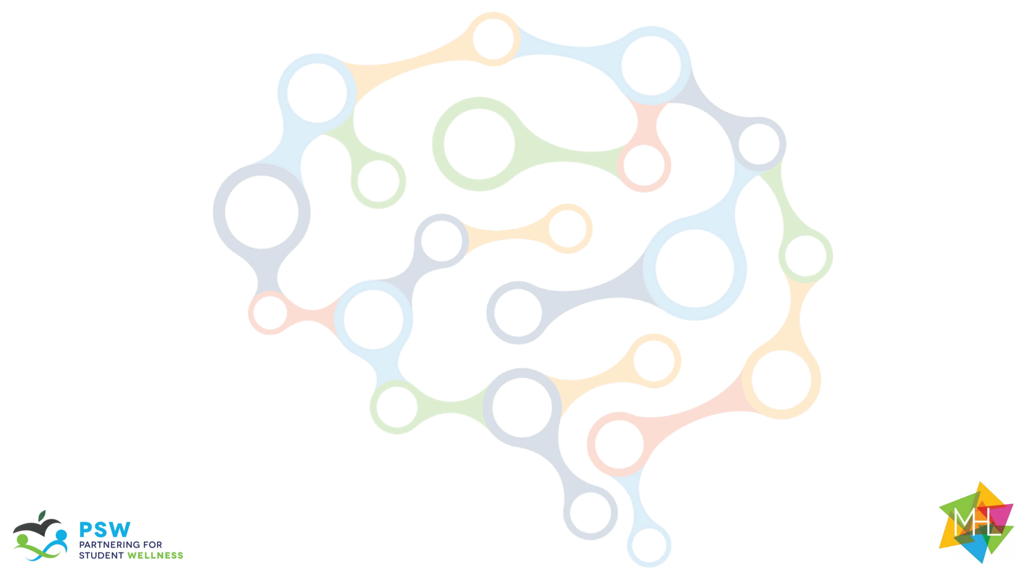
The Guide
Understanding Mental Health
and Mental Illness

Slide 2
Table of Contents
Topic A: What is mental health?
Topic B: How is the brain involved in mental health?
Topic C: What is stigma?
Topic D: How can a person find support?
Topic E: How can positive mental health be maintained?

Slide 3

Acknowledgements
Research reported in this work was funded through a Patient-Centered Outcomes Research Institute (PCORI) Project Program Award (IHS-2018C1-10928). The views in this work are solely the responsibility of the authors and do not necessarily represent the views of the Patient-Centered Outcomes Research Institute (PCORI), its Board of Governors, or Methodology Committee.

Slide 4
Acknowledgements: The Guide Citations
McLuckie, A., Kutcher, S., Wei, Y (Co-PI)., & Weaver, C. (2014). Sustained improvements in students’ mental health literacy with use of a mental health curriculum in Canadian schools. BMC Psychiatry, 14(1), 379. doi: 10.1186/s12888-014-0379-4 (The Guide)
Milin, R., Kutcher, S., Lewis, S., Walker, S., Wei, Y (Contributor)., Ferrill, N., & Armstrong, M. (2016). Impact of a mental health curriculum on knowledge and stigma among high school students: a randomized controlled trial. Journal of American Academy of Child and Adolescent Psychiatry, 55(5), 383-391.e1. doi: 10.1016/j.jaac.2016.02.018 (The Guide 2016 RCT)

Slide 5
Slide Notes
Each slide deck follows the same format. Once you are comfortable with the layout and process for Topic A, the rest should be very easy to follow.
Each slide includes presenter notes that include the following elements, as applicable:
  Say – a brief script you can follow or adapt to fit your style and classroom needs
  Ask – question(s) to initiate conversation and engagement with students
  Do – an action you can initiate (e.g., “call on a few students to respond.”)
Some slides offer options in the notes section for how you might facilitate each activity. Educators should be able to quickly review the slide deck and accompanying notes before implementing in the classroom.

Slide 6
Outline for Topic D
Topic D: How Can a Person Find Support?
Background Information for Facilitators | Topic D Knowledge for Facilitators
Introduction: | Core topics include: Teens explore normative social development and learn what it could look like when a teen is struggling. How to find and access those additional supports as well as what those supports may look like. Exploring different aspects of mental health supports, including accessing help, different interventions, and potential outcomes.
Review: | Rules and Incentive System (if available) Important information from C- are there any questions from last session Brief overview of A and B
Topic Activities: | Activity 1 : Common Stressors for Teens Activity 2 : Accessing Support Activity 3 : Staying Well Activity 4: Getting Help
Optional Activities: | Sorting Activity
Conceptual Understanding: | Real Life Example

Slide 7
Session Goals
Learn about typical teen development
Identify when additional support is needed
Teach that getting help early increases the chances that a person can live well
Teach that there are a range of evidenced-based treatments to support recovery
Teach wellness skills to maintain recovery

Slide 8
Materials and Preparation Needed
Materials
Power Point: Topic D
Spinners
What if scenarios
Student Handouts: Topics for Teens
Teacher Handouts: None
Preparation
Read “Background for Facilitators” in the implementation guide/brief background in slide deck
Review “How to Parent My Teen” and “How to Teen my Parent”
Separate “what if” scenarios
Arrange classroom for group work if necessary
Gather additional materials: Post-It notes, spinners, and a list of local mental health resources
Prep Conceptual understanding activity in advance. What “project” do you want students to do?
Optional Extension activity

Slide 9
Background Knowledge
Many people need support to deal with stressful life events and situations. Such support often includes assistance with distinguishing between an appropriate or typical stress response to a new situation and responses that are hindering healthy function and development (indicating a need for additional strategies or support from health professionals).
Seeking help and finding support for mental health problems or mental illness can be tricky business. From the outside, it’s often not clear when intervention is necessary, and people who are experiencing a mental illness may themselves not always be aware of what’s going on, or reluctant to come forward for fear of being stigmatized. When people know that they will not be stigmatized, and when they know where to go for help, they are more likely to seek help. Early intervention is important and increases the chances of living well with a diagnosis.

