Slide 1
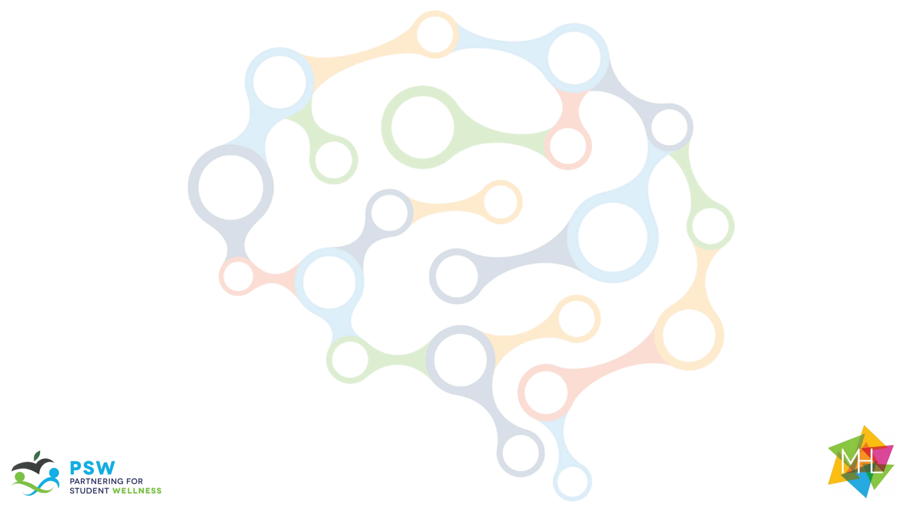
The Guide
Understanding Mental Health
and Mental Illness

Slide 2
Table of Contents
Topic A: What is mental health?
Topic B: How is the brain involved in mental health?
Topic C: What is stigma?
Topic D: How can a person find support?
Topic E: How can positive mental health be maintained?

Slide 3

Acknowledgements
Research reported in this work was funded through a Patient-Centered Outcomes Research Institute (PCORI) Project Program Award (IHS-2018C1-10928). The views in this work are solely the responsibility of the authors and do not necessarily represent the views of the Patient-Centered Outcomes Research Institute (PCORI), its Board of Governors, or Methodology Committee.

Slide 4
Acknowledgements: The Guide Citations
McLuckie, A., Kutcher, S., Wei, Y (Co-PI)., & Weaver, C. (2014). Sustained improvements in students’ mental health literacy with use of a mental health curriculum in Canadian schools. BMC Psychiatry, 14(1), 379. doi: 10.1186/s12888-014-0379-4 (The Guide)
Milin, R., Kutcher, S., Lewis, S., Walker, S., Wei, Y (Contributor)., Ferrill, N., & Armstrong, M. (2016). Impact of a mental health curriculum on knowledge and stigma among high school students: a randomized controlled trial. Journal of American Academy of Child and Adolescent Psychiatry, 55(5), 383-391.e1. doi: 10.1016/j.jaac.2016.02.018 (The Guide 2016 RCT)

Slide 5
Implementation Planning
This content can be delivered over weeks or months, depending on your preference and time you have available. For example:
You could dedicate one week to Mental Health Literacy, covering Topic A on Monday, Topic B on Tuesday, and so forth; allocating 60-90 minutes per day.
You could stretch the content across a semester, designating, for example, Mental Health Mondays. In this way, you might spend 15 minutes each week on one activity:
  Week 1 is Topic A: Activity 1
  Week 2 is Topic A: Activity 2…
Customize your teaching plan according to your students’ and your own scheduling needs. However it is strongly recommended to deliver the curriculum in the order as indicated (from A to E), rather than starting with a later Topic then returning back to an earlier one.

Slide 6
Slide Notes
Each slide deck follows the same format. Once you are comfortable with the layout and process for Topic A, the rest should be very easy to follow.
Each slide includes presenter notes that include the following elements, as applicable:
  Say – a brief script you can follow or adapt to fit your style and classroom needs
  Ask – question(s) to initiate conversation and engagement with students
  Do – an action you can initiate (e.g., “call on a few students to respond.”)
Some slides offer options in the notes section for how you might facilitate each activity. Educators should be able to quickly review the slide deck and accompanying notes before implementing in the classroom.

Slide 7
Outline for Topic B
Topic B: How is the Brain Involved in Mental Health
Background Information for Facilitators | Topic B: Knowledge for Facilitators
Introduction: | Core topics include: How the teen brain works and the states of mental Health
Review: | Rules and Incentive System (if available)
Topic Activities: | Activity 1 : The brain is in Control Activity 2 : Emotions and Mental Health
Optional Activities: | NA
Conceptual Understanding: | Real – Life Example

Slide 8
Session Goals
Learn about the brain and its importance
Define and distinguish between four states of mental health
Identify the brain’s role in our emotions and mental state
Discuss the parts of the brain and how it works

Slide 9
Materials and Preparation Needed
Materials
Power Point: Topic B
Make sure you can play “Teen Brain HD” (embedded/linked on slide 9), Teen Brain HD
Prepare large tablet paper or write on the board: What is mental health?” on one side and “What is mental illness?” on the other
Consider offering a “prize” or incentive for the game at the end, if resources are available
Student Handouts: None
Teacher Handouts: None
Preparation
Read “Background for Facilitators” in subsequent slides
Enter in correct teacher/clinician names and school information on slides 7 and 59
Have prepared larger tablet paper/or write on the board: What is mental health?” on one side and “What is mental illness?” on the other for Activity 1.
Prep Conceptual understanding activity in advance. What “project” do you want students to do?
Consider offering a “prize” or incentive for the game at the end

Slide 10
Background Knowledge
Brain growth and development are influenced by three main factors: genetics, early environment (beginning in the womb) and current environment. During the teenage years, the brain grows and will undergo many important changes. One of the most important changes in the brain during the teenage years is the development of the frontal lobes – the part of the brain just behind the forehead. This part of the brain is responsible for something called executive functioning, which supports problem solving, planning, social awareness, strategic thinking, risk assessment and impulse inhibition. The frontal lobes continue to grow and develop during adolescence and don’t actually stop growing until usually the mid-twenties, which explains a lot about risky adolescent behavior.
For further information, watch How Brains are Built from the Alberta Family Wellness Initiative.
Exploring the states of mental health enables us to better understand it as a concept. The states are: no distress, mental distress, mental health problems and mental illness. A person can be in each of these mental health states at one time. For example, over the course of one day, a person can be laughing and having fun with their friends (no distress), can experience distress (a lost house key), be experiencing a mental health problem (sad, lonely feelings resulting from the death of a close uncle who passed away earlier in the week) and be diagnosed with a mental disorder (such as Attention Deficit Hyperactivity Disorder).
It is important to understand that everyone has mental health just like everyone has physical health. Just like a person can have good physical health and at the same me have a physical illness, people can have good mental health, and mental illness at the same me.

Slide 11
Background Knowledge
The 4 States of Mental Health
(1) No distress is a neutral state when a person is feeling at ease, settled or balanced.
(2) Mental distress is the inner signal of stress that a person feels when something in their environment is demanding that they adapt to a challenge (e.g., wring a test, giving a presentation in front of the class, asking a person to go out on a date, failing to make a school sports team). This signal is called a “stress signal” or “stress response." Mental distress has different components to it: emotions (e.g., worry, unhappiness, feeling energized, annoyance), thoughts (e.g., negative thoughts such as “I am not good at anything," “I wish I did not have to do this," or positive thoughts such as “this is something I need to solve," “it may be difficult but I can do this," “I should ask my friend for their advice”), physical symptoms (e.g., stomach aches and headaches, the “butterflies”) and behaviors (e.g., avoidance of the situation, engagement of the challenge, positive energy, withdrawal from others, yelling at someone or helping someone).
Everybody experiences mental distress (often called “stress”) every day. The distress goes away once a person has successfully overcome the challenge but the learning and skill sets remain. This process is called adaptation or resilience building. This is part of growing up. Allowing young people to avoid everyday mental distress, or to focus only on teaching them how to regulate the stress response instead of how to use it to learn new skills, can have negative impacts on their development of skills that they need to learn in order to have successful adult lives.

Slide 12
Background Knowledge
(3) Mental health problems may arise when a person is faced with a much larger stressor than usual. Large stressors will and do occur as an expected part of normal life and are not mental illnesses. For example: death of a loved one, moving to a new country, having a serious physical illness, etc. When faced with large stressors, everyone experiences difficult emotions (such as: sadness, grief, anger, demoralization, etc.). Emotions can signal a mental health problem when accompanied by substantial difficulties in other domains such as: thought (e.g., “nothing will ever be the same”), physical functioning (e.g., sleep problems, loss of energy, numerous aches and pains) and behavior (e.g., social withdrawal, avoidance of usual activities, angry outbursts, etc.). Young people experiencing a mental health problem will often need additional support to help them through the difficult situation or assist them with problems in functioning (e.g., extra me for academic activities, me away from school to be with their families). In such cases, this support can come from a counsellor, a religious leader, or another person who has the skills needed to help effectively. Medical treatment (medication or psychotherapy) is usually not necessary. The presence of a supportive adult (e.g., teacher, parent or neighbor) is a key component that helps young people deal with a mental health problem.

Slide 13
Background Knowledge
(4) A mental illness is very different from mental distress and from a mental health problem. Mental illness arises from a complex interplay between a person’s genetic makeup and the environment in which they live or have been exposed to at different times in their lives. Many interventions that help with mental distress and mental health problems can also be used to help a person who has a mental illness, such as general health enhancing activities. However, a student with a mental illness requires a degree of care above and beyond that usually provided for a mental health problem. Diagnosed by trained health professionals (e.g., doctors, mental health clinicians, psychiatric nurses and psychologists) using internationally established diagnostic criteria, a person with a mental illness is best helped by trained health professionals providing the best evidence-based treatments. A person with a mental illness will experience significant, substantial and persistent problems with emotions/feelings (e.g., depression, panic attacks, overwhelming anxiety), thought (e.g., delusions, hopelessness), physical symptoms (e.g., fatigue, lethargy, excessive movement), and behavior (e.g., refusal to attend school, withdrawal from family and friends, poor self-care). Evidence-based interventions for mental illness include medications, psychotherapies and social interventions, which should be provided by appropriately trained health care providers. A healthy learning environment during adolescence can contribute to healthy brain development. It is important that educators teach how getting enough sleep, eating healthy, exercising, having positive social and family relationships and learning to manage the stress that comes with life challenges, as they all contribute to good brain health. Conversely, it is also beneficial to explain that head injury, poor nutrition, lack of sleep, negative peer groups and substance-use can all have a negative impact on brain development.

