Slide 1
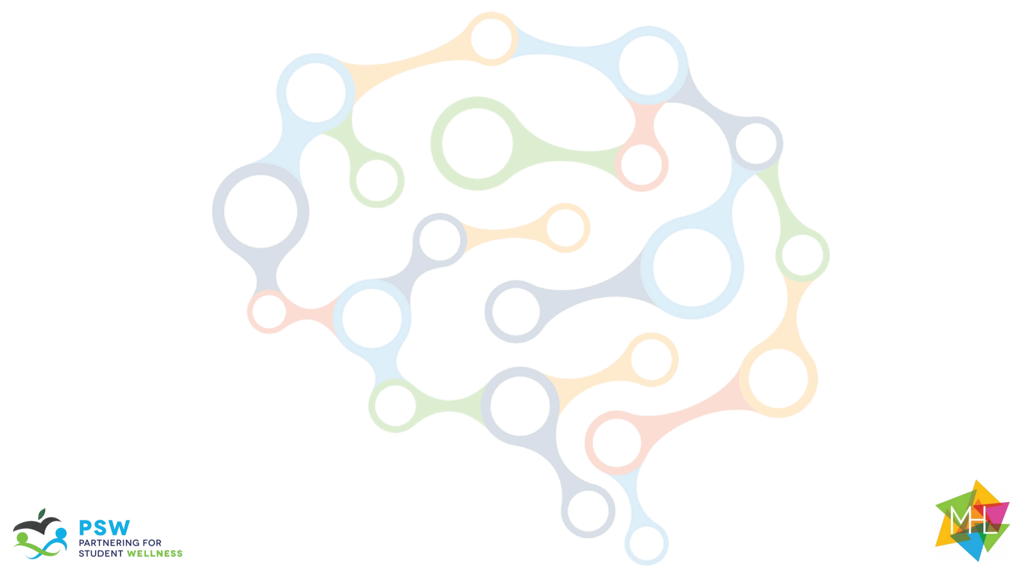
The Guide
Understanding Mental Health
and Mental Illness

Slide 2
Table of Contents
Topic A: What is mental health?
Topic B: How is the brain involved in mental health?
Topic C: What is stigma?
Topic D: How can a person find support?
Topic E: How can positive mental health be maintained?

Slide 3

Acknowledgements
Research reported in this work was funded through a Patient-Centered Outcomes Research Institute (PCORI) Project Program Award (IHS-2018C1-10928). The views in this work are solely the responsibility of the authors and do not necessarily represent the views of the Patient-Centered Outcomes Research Institute (PCORI), its Board of Governors, or Methodology Committee.

Slide 4
Acknowledgements: The Guide Citations
McLuckie, A., Kutcher, S., Wei, Y (Co-PI)., & Weaver, C. (2014). Sustained improvements in students’ mental health literacy with use of a mental health curriculum in Canadian schools. BMC Psychiatry, 14(1), 379. doi: 10.1186/s12888-014-0379-4 (The Guide)
Milin, R., Kutcher, S., Lewis, S., Walker, S., Wei, Y (Contributor)., Ferrill, N., & Armstrong, M. (2016). Impact of a mental health curriculum on knowledge and stigma among high school students: a randomized controlled trial. Journal of American Academy of Child and Adolescent Psychiatry, 55(5), 383-391.e1. doi: 10.1016/j.jaac.2016.02.018 (The Guide 2016 RCT)

Slide 5
Implementation Planning
This content can be delivered over weeks or months, depending on your preference and time you have available. For example:
You could dedicate one week to Mental Health Literacy, covering Topic A on Monday, Topic B on Tuesday, and so forth; allocating 60-90 minutes per day.
You could stretch the content across a semester, designating, for example, Mental Health Mondays. In this model, you might spend 10-20 minutes each week and during each week, cover one activity.
  Week 1 is Topic A: Activity 1
  Week 2 is Topic A: Activity 2…
Customize your plan according to your students’ and your own scheduling needs.

Slide 6
Slide Notes
Each slide deck follows the same format. Once you are comfortable with the layout and process for Topic A, the rest should be very easy to follow.
Each slide includes presenter notes that include the following elements, as applicable:
  Say – a brief script you can follow or adapt to fit your style and classroom needs
  Ask – question(s) to initiate conversation and engagement with students
  Do – an action you can initiate (e.g., “call on a few students to respond.”)
Some slides offer options in the notes section for how you might facilitate each activity. Educators should be able to quickly review the slide deck and accompanying notes before implementing in the classroom.

Slide 7
Outline for Topic A
Topic A: What is mental health?
Background Information for Facilitators | Topic A Knowledge for Facilitators
Introduction: | Core topics include: The Guide Purpose and Curriculum Topics
Review: | Rules and Incentive System (if available)
Topic Activities: | Activity 1 : Loaded Language Activity 2 : The Power of Words Activity 3 : A Physical Analogy Activity 4 : States of Mental Health
Optional Activities: | Sorting Activity
Conceptual Understanding: | Real Life Example

Slide 8
Goals, Materials, and Preparation
SESSION GOALS
Define mental health
Distinguish between mental health and mental illness
Demonstrate use of appropriate terminology to represent emotional and feeling experiences
MATERIALS AND PREPARATION NEEDED
Materials
Power Point: Topic A
Student Handouts: Student worksheet: Let’s Get Physical
Teacher Handouts: Let’s Get Physical (answer key) and Sorting Scenarios (answer key)
Preparation
Read “Background for Facilitators” in the implementation guide/brief background in slide deck
Prep Conceptual understanding activity in advance. What “project” do you want students to do?
Optional Extension activity – have YouTube clip (or alternative videos) ready. https://drive.google.com/drive/u/0/folders/1LdGBBu9iUYhDShpoKqwiYqUK0TFcFhkf

Slide 9
Background Knowledge
Most young people have heard about mental health and mental illness. However, it is quite common that students mistake or misrepresent the two concepts. Adding to the confusion, students may turn to social media for guidance where users frequently refer to terms associated with mental illness to describe normal life (such as “ I am traumatized” for “I am upset" or “I am depressed” for “I am unhappy”. These expressions perpetuate stigma and do not provide clear or consistent understanding.
Everyone has mental health regardless of whether they have mental illness. Changes in brain function lead to changes in thoughts, feelings and behaviors that can last a short or long me. A mental illness affects a person’s thinking, feelings or behavior (or all three) and causes that person difficulty in functioning. Mental illnesses have complex causes, including a biological basis, and are therefore not that different from other illnesses. As with all illnesses, the sooner people get help and receive effective treatment for mental illness, the better their long- and short-term outcomes. Many of the major mental illnesses begin to emerge during adolescence, which is why it is so important that middle schools students learn about them.

Slide 10
Facilitator Guidance
For Activity I: Loaded Language
If concerns arise or a student reports something concerning:
Know who you can make referrals to - either school social worker, school-based mental health clinician, or school counselor.
Say: “Thank you for sharing. We are talking about topics that can be complex or challenging to discuss. I would like to hear more and (not “but”) I want to also make sure we all get to go through the material in this lesson. Let’s chat privately after class because I can see it is important."
Provide the student with the referral information privately and/or check back with the parent. Explain that you want to be sure their needs are addressed, and this is someone who can help.

